Slide 1
Information Architecture for Standards at HFES.org
Tasha Y. David

Slide 2
Agenda
Purpose
Objectives
What we did…
What we discovered
Our game plan
Next Steps
  Card Sorting Activity
Usability testing
  Results
Summary & Conclusion
Recommendations

Slide 3
Purpose
Identify users who need HF standards
  Professionals
  Faculty
  Students
Educate HFES members about standards
  Who needs them
  Why they need them
  How they are developed
  When they need to be used

Slide 4
Objectives
Help users find standards effortlessly
Help users understand where they need to go
  Standards
  Educational Resources
Identify usability goals for these sites

Slide 5
What we did…
User profile
  Three users groups:
    (1) Professional, (1) Faculty member, (1) Student
  Needs vary from very general knowledge to a more in depth description.
  Frequency of site usage was low (> once a month)
Informal interviews, in person and over phone
  Lasted 20-30 minutes
  Identified key issues/usability goals to focus on for usability testing and prototype development

Slide 6
What we discovered…
Informal Interviews:
  Users experienced difficulty finding standards
  Overall, users did not know standards are in 2 locations
    Expected all things related to standards to be found in one place
  Users did not understand why they are separated.
  Users especially disliked the difficulty findings standards on EDU tab
  Expected there to be a description of what standards are and how they are used
  Users wanted navigation to be consistent on both of the landing pages.
Comments:
  “There is too much text here, difficult to find anything useful”
  “I would use the search box because there is too much content to search through”
  “I expected to see a list of standards…”
  “Why would I go to the educational resources tab to find info about standards?”

Slide 7
Our Game Plan…
Standards section:
Organize landing page with less text in smaller sections.
Needs a basic general description of standards
  What they are, why they are used
  A link to Educational Resources if they want more details on the topic.
ISO and ANSI (general description of each and listings, with link for more info)
Listing of current standards and descriptions of each
  All that fall under human factors or affect human factors
Listing of standards that can be purchased through HFES.org and where to purchase
Listing of Interest Group
  Who they are and what they do

Slide 8
Our Game Plan…
Educational Resources section:
Organization of section to include systematic navigation
  Navigation should match Standards section, breadcrumbs
  This section is dedicated to all things educational, so there should be a way to organize the section into high-level topics
    Undergraduate programs, Graduate programs, Careers, Standards, etc.
Should include an in depth description of standards
  What standards are, why we need them, & how are they used
  How standards are formed
    The process for each organization ISO and ANSI
Tools for teaching/educating members and students
  Presentations, papers, and research materials
Listing of human factors standards and fields that use them

Slide 9
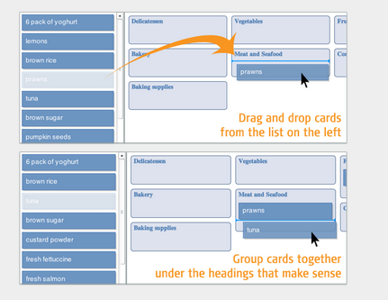
Next Steps
Card sorting software called Optimal Sort
  Card sorting is a method of finding patterns in how users would expect to find content or functionality.
  Generates an overall structure for your information, as well as suggestions for navigation, menus, and possible taxonomies.
Here is an example of what users saw when they opened the activity.

Slide 10
Card sort
There are 2 options for the card sort:
  Open – Participants are given cards showing site content with no pre-established groupings.
    They are asked to sort cards into groups that they feel are appropriate and then describe each group.
    Open card sorting is useful as input to information structures in new or existing sites and products.
  Closed – Participants are given cards showing site content with an established initial set of primary groups.
    They are asked to place cards into these pre-established primary groups.
    Closed card sorting is useful when adding new content to an existing structure, or for gaining additional feedback after an open card sort.

Slide 11
Next Steps
We used an open card sort
  Participants are given cards showing site content with no pre-established groupings
    They are asked to sort cards into groups that they feel are appropriate and then describe each group.
    Open card sorting is useful for inputting information into structures in new or existing sites and products
  15 Participants, professionals and students
  Card sorting activity was separated into 2 sections:
    Standards
    Educational Resources
  Time to complete, 15-20 minutes each.

Slide 12
Card Sorting Results
Users sorted the Standards Section into:
HFES Standards
  Standards at HFES
  Purchasing standards
General Info About Standards
  Definition of Standards
  Importance of Standards
  Purpose of Standards
  Who Standards Benefit
  The content of a Standard
Other Standard Organizations
  ANSI
  About ANSI and History
  ISO
  About ISO and history
Getting involved in Standards
  Standards Development
  Technical Committees

Slide 13
Card Sorting Results
Edu. Section is not solely devoted to Standards, but we treated the card sorting activity the same as the Standards Section
Users sorted the Educational Resources Sections into:
Resources Materials About Standards
  Learn About Standards
  History of Standards
  Presentations on Standards
  Resources for learning
Human Factors Related Standards
  Government Standards on H/F Designs
  List of Human Factors Standards
  Standards related to Accessibility
Standard Development
  Development of Standards
  ANSI Development Process
  ISO Development Process

Slide 14
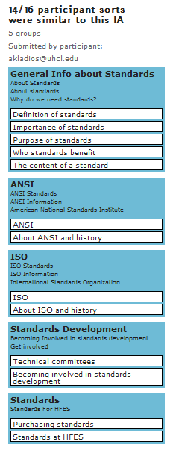
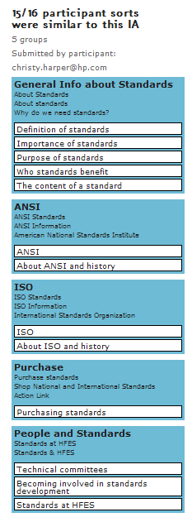
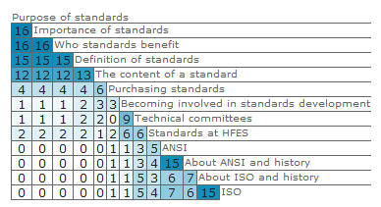
Card sort Results - Standards
Structure of the prototype was derived from here.
Similarity Matrix – a matrix of scores which express the similarity between two data points

Slide 15
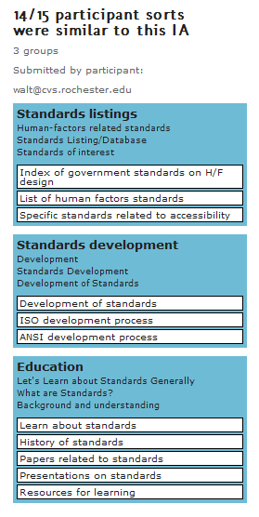
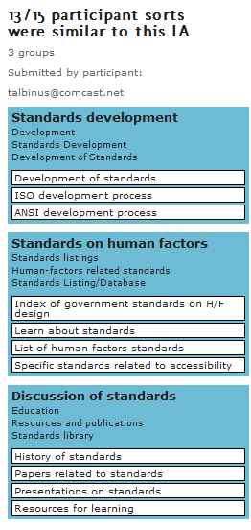
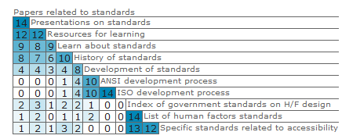
Card Sort Results - Educational

Slide 16
Usability Testing
Users were presented tasks and asked to use the prototype
  8 Tasks:
    Find HFES standards publication
    Where would you go to buy a standards
    Locate other standards
    Who else offers standards
    Where would you go to learn about standards
    Find standards related to accessibility
    How are standards made
    Contact person for HFES standards
  Users were rated on whether tasks were completed

Slide 17
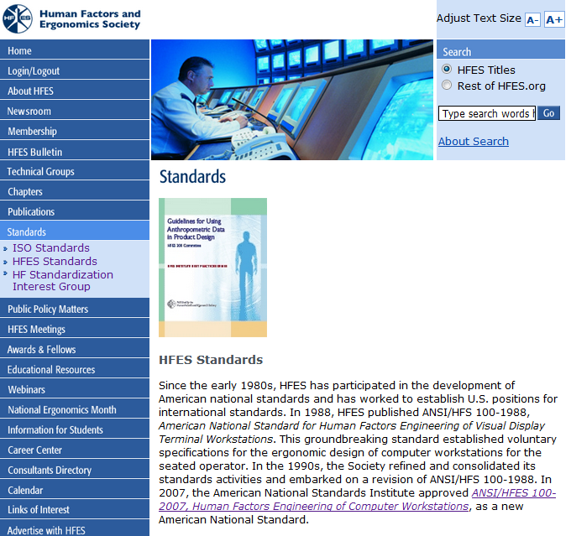
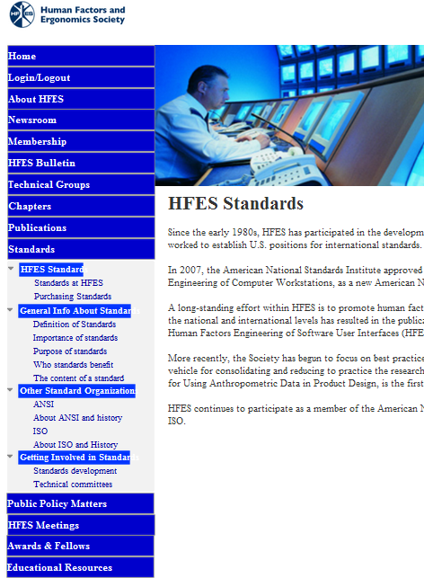
BEFORE
PROTOTYPE
Increased pathways for easier navigation
Reduced amount of content, separated into smaller sections

Slide 18
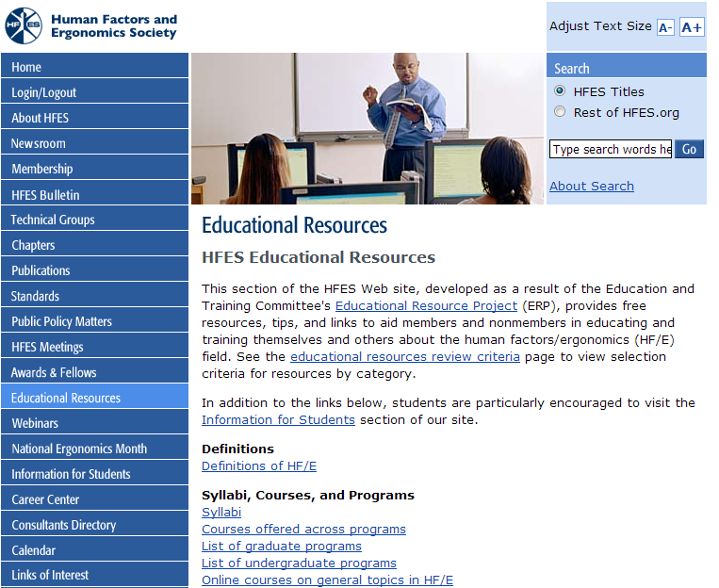
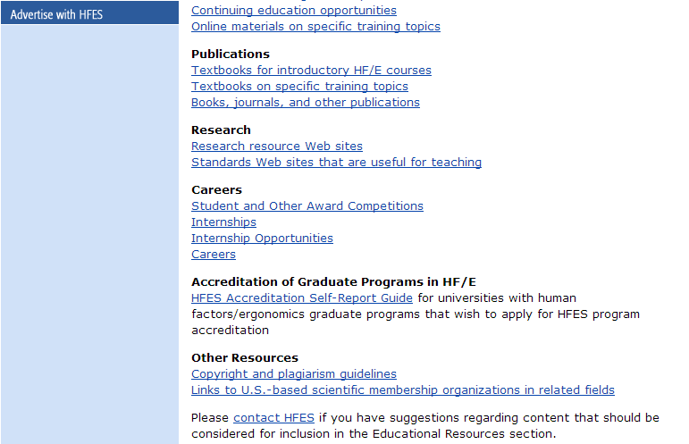
Educational Resources
Red line represents “below the fold”
Link for Standards is here!
Notes:
The standards piece lies below the fold, so it is easy to miss and it is listed in the Research Section
Also, it is buried in a large amount of texts and links.

Slide 19
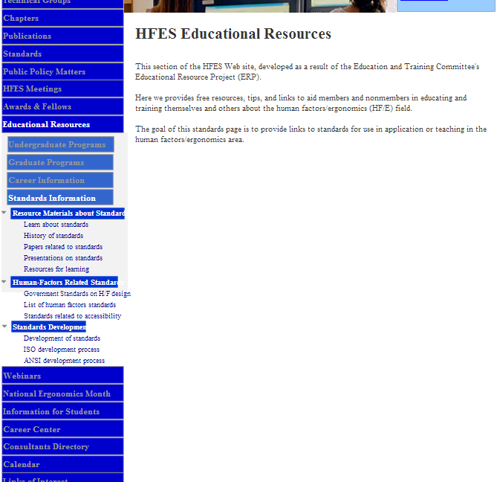
Prototype
Reduced amount of content to match Standards section
Added navigation tabs for Standards within Educational Resources Section
Notes:
The Content for the sections were not the primary goal of this exercise

Slide 20
Testing Results
0 - was not able to complete task 1 - was able to complete task with difficulty 2 - was able to complete task without difficulty | Participant 1 | Participant 2 | Participant 3 | Participant 4 | Participant 5
Find HFES’ Standards Publications | 2 | 2 | 2 | 2 | 1
Buying a standard | 2 | 2 | 2 | 2 | 2
Locate other standards | 2 | 2 | 1 | 2 | 2
Who else offers Standards? | 2 | 2 | 2 | 2 | 2
Where would you go to learn about Standards? | 0 | 0 | 0 | 0 | 0
Find Standards related to accessibility | 2 | 2 | 2 | 1 | 2
How are standards made? | 2 | 2 | 2 | 2 | 1
How would you contact someone @ HFES to ask more about standards? | 0 | 0 | 0 | 0 | 1

Slide 21
Summary and Conclusions
Summary:
  Increasing navigation pathways increased navigation success, 75%.
  Of the 75% only a few completed tasks with difficulty
  Navigating to sections within Educational Resources remains problematic
  Majority of users were confused as to why standards are separated into 2 sections.
  “I would never think to look in Educational Resources, not if I’m looking for standards”
  “Why are they separated? Everything should be together, much easier that way”
Conclusion
  Overall, the new design increased successful navigation.
  “For the most part, it was very easy to use”

Slide 22
Recommendations
Reduce overall content on landing pages.
  Users did not spend anytime reading the current material
  Aesthetics are also important to users
Provide a more detailed left navigation
  Users were able to find what they were looking for at a glance
  Users did not need to remember where to go
Provide a link to the Educational Resources section within the standards sections.
  All the users went to the Standards section first
  Users expressed confusion as to why they needed to navigate to Educational Resources to access standards.
    The title gives no indication that standards would be there.
  Infrequent or new users will be able to access the standards in the education section if they need more information.

Slide 23
Thank You

